Slide 1


IS457
Mobile Applications
Lecture 2
Mobile Framework

Slide 2
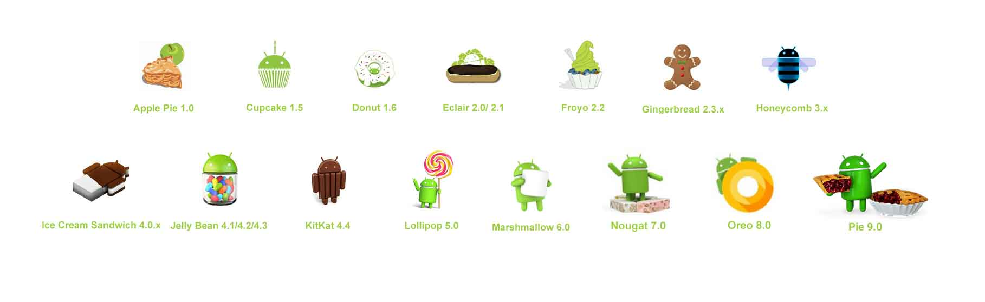
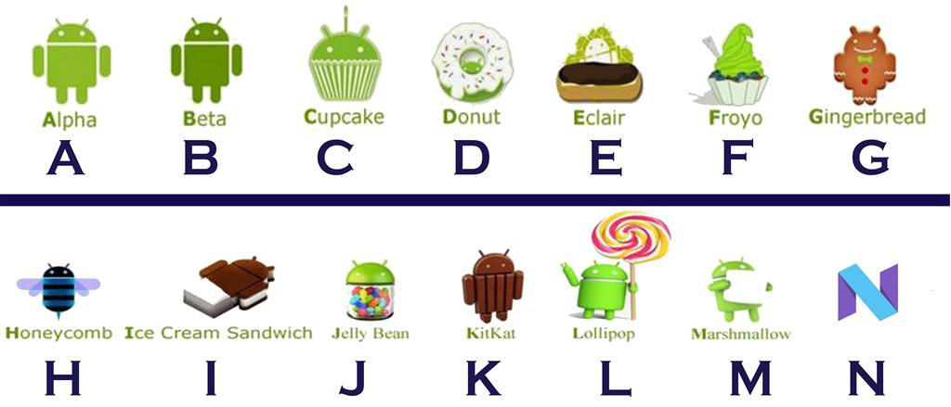


Android Versions
Alpha and beta were the earliest versions of Android. Then, when Google bought Android, it was decided to use a code name for each new version based on dessert items in alphabetical order.

Slide 3
Android SDK
Android Software Development Kit (SDK) is a set of development tools that allows developers to build, test, and debug applications for the Android platform.

Slide 4



Android NDK
The Native Development Kit (NDK) is a set of tools that allows you to use C and C++ code with Android.
Provides platform libraries you can use to manage native activities and access physical device components, such as sensors and touch input.
Not be appropriate for most novice Android programmers.
Squeeze extra performance out of a device to achieve low latency or run computationally intensive applications, such as games or physics simulations.
Examples apps use NDK

Slide 5
SDK and NDK
Similarities…..
Differences…..
Programming language
Performance
Features

